Slide 1



Capstone Project Presentation

Slide 2


GOAL
To provide a complete guideline for students to present effectively.
To provide sample tools used for presenting.
To cite examples for presentions’ reference.
To develop soft skills needed before graduation.
Notes:
This slide is optional

Slide 3
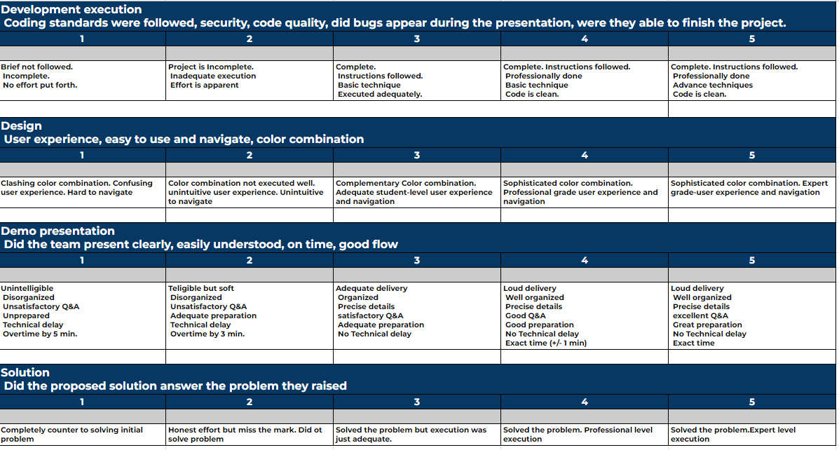
Rubric

Slide 4
Presentation Layout
Color palette MUST be the same as the launched project layout.
Layout must be two to three colors.
Words must be readable.
Details must be bulleted. Avoid writing in paragraph.

Slide 5

Example Layout
Sample Details
Sample Details
Sample Details

Slide 6



Recommended Tools

Slide 7
Research Background
Provide details on how the idea is formulated in the said project.
Provide details on how it was made.
Provide bottlenecks while creating the project.
Provide details on how the project is finished.

Slide 8
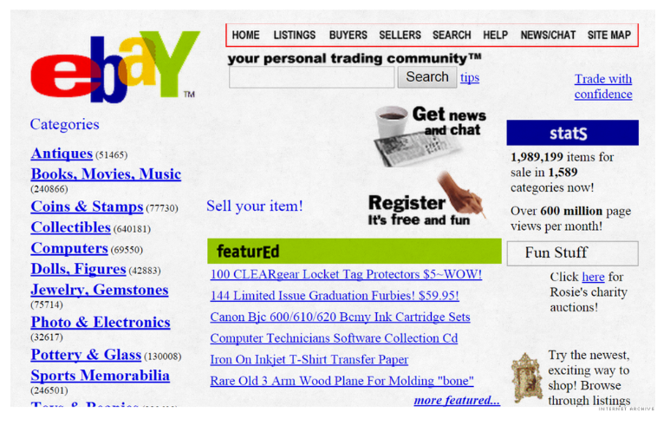
Example Research Background
Webpages are unresponsive.
Webpages are not user friendly.
Broken web links.
Legend: Explain the project solution.

Slide 9
Features and Solution
Webpages are responsive to different devices.
Webpages are very interactive with the user.
Broken links are mitigated.

Slide 10






Tools and Frameworks

Slide 11
Site Walkthrough
Prepare your deployed website for walkthrough
Show the best features of your website first.
Proceed with your website processing until the finished phase.

Slide 12
Q & A
Provide a disclaimer.
Ex: Questions and Answers can be entertained after the presentation.
Reason: To avoid destroying everyone’s momentum.
Prepare a separate slide for Q & A at the end of your presentation.

Slide 13
Example
Q & A

Slide 14

Thank You!

